Slide 1
Docker, Alembic, FastAPI, Logging

Slide 2
Docker
Docker lets us package apps + its OS level environment into a reproducible box.
Those boxes are called images.
When you run an image you get a container.
A Dockerfile is a recipe for building images.

Slide 3
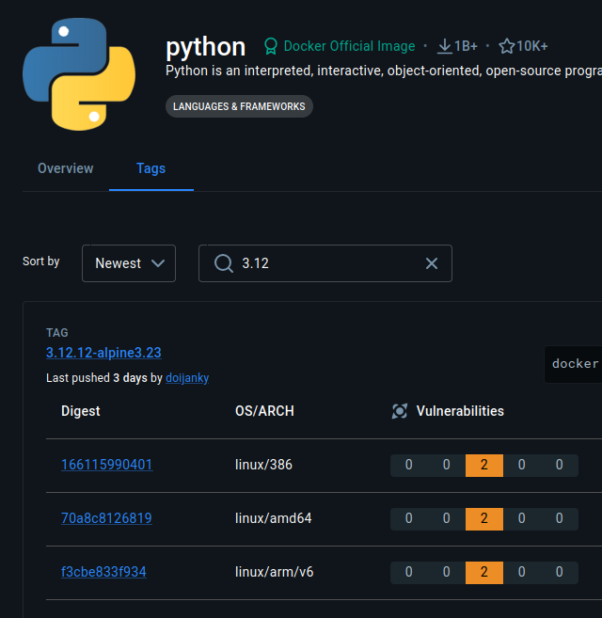
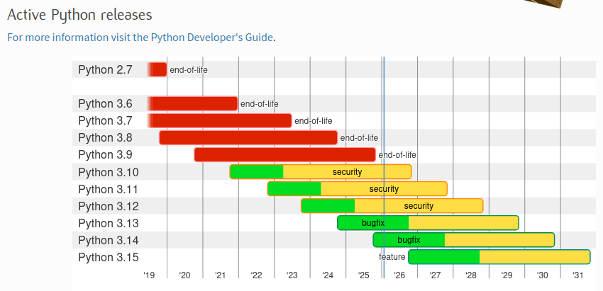
Consider your version
Docker Hub:
Python doesn’t do “LTS” releases.

Slide 4
Packages
Pyproject.toml new dependencies:
Sqlalchemy - maps python objects to database tables
Psycopg[binary] - driver to communicate with postressql
Sqlalchemy-utils - misc utilities
Alembic - managed db schema migrations
Python-dotenv - work with env variables
Fastapi - routes HTTP request to python code
Uvicorn - runs your web app and handles network traffic
Pydantic - provides serialization, DTO-like functionality
Run ‘poetry run alembic init alembic’ to generate folders/files for migrations

Slide 5
Single vs Multi-Stage Dockerfiles
Ships Everything: Only ships what’s needed:
FROM node:20
WORKDIR /app
COPY . .
RUN npm install && npm run build
CMD ["npm", "start"]
FROM node:20 AS builder
WORKDIR /app
COPY . .
RUN npm install && npm run build
FROM node:20-slim
WORKDIR /app
COPY --from=builder /app/dist ./dist
COPY --from=builder /app/node_modules ./node_modules
CMD ["node", "dist/index.js"]

Slide 6
Multi-Stage Image - Python App
FROM python:3.12-slim AS builder
WORKDIR /app
RUN apt-get update && apt-get install -y curl build-essential
RUN curl -sSL https://install.python-poetry.org | python3 -
ENV PATH="/root/.local/bin:$PATH"
COPY pyproject.toml poetry.lock /app/
RUN poetry config virtualenvs.create false
RUN poetry install --without dev --no-interaction --no-ansi
ENV PATH="/usr/local/bin:/root/.local/bin:$PATH"
COPY src /app/src
COPY src/repl.py /app/repl.py
COPY alembic.ini /app/alembic.ini
COPY alembic /app/alembic
Stage 1: builder
- Install system deps
- Install Poetry
- Set PATH to Poetry
- Turn off venv generation
- Install Python dependencies
- Add Alembic/uvicorn to PATH
- Copy source code/migrations

Slide 7
Multi-Stage Image - Python App
Stage 2: runtime
- We start with clean Python image - no curl, no build tools, no poetry install script, much smaller
- Copy only built artifacts
- Python Packages
- Source Code
- Poetry Binary
- Run the app
FROM python:3.12-slim
WORKDIR /app
COPY --from=builder /usr/local/lib/python3.12 /usr/local/lib/python3.12
COPY --from=builder /app /app
COPY --from=builder /usr/local/bin /usr/local/bin
ENV PYTHONUNBUFFERED=1
ENV PATH=”/usr/local/bin:/root/.local/bin:$PATH”
CMD ["uvicorn", "src.main:app", "--host", "0.0.0.0", "--port", "8000"]

Slide 8
Docker Compose
Docker Compose is a tool to define and run multi-container applications.
Spin up multiple containers at once
Define dependencies between services
Share environment variables
Manage volumes (persist data between restarts)

Slide 9
Super Ugly Docker Compose Slide :) sorry
services:
app:
build: .
container_name: myapp
env_file:
- .env
#volumes:
# - .:/app
depends_on:
db:
condition: service_healthy
ports:
- "8000:8000"
command: ["uvicorn", "src.main:app", "--host", "0.0.0.0", "--port", "8000"]
db:
image: postgres:15
container_name: mydb
env_file:
- .env
environment:
POSTGRES_USER: ${POSTGRES_USER}
POSTGRES_PASSWORD: ${POSTGRES_PASSWORD}
POSTGRES_DB: ${POSTGRES_DB}
ports:
- "5432:5432"
volumes:
- postgres_data:/var/lib/postgresql/data
healthcheck:
test: ["CMD-SHELL", "pg_isready -U ${POSTGRES_USER} -d ${POSTGRES_DB}"]
interval: 5s
timeout: 5s
retries: 5
volumes:
postgres_data:

Slide 10
First Migration / Build

Slide 11
Other Helpful Commands
alembic upgrade <revision> = Applies migrations up to the specified revision. head applies all pending migrations.
alembic downgrade <revision>
Rolls back migrations. Examples:
alembic downgrade -1 → step back 1 revision
alembic downgrade base → go back to the initial state
alembic history = Shows the list of all migrations and their revision IDs.
alembic current = Displays the current revision(s) applied to the database.
alembic heads = Shows the latest revision(s) in the migration tree (useful if you have multiple heads/branches).
alembic branches = Lists any branching points in your migration history.

Slide 12
Logging
Logs help us audit issues
Logs help us audit events
Logs may be required due to compliance
Logs are a good practice
We can print to files (not recommended)
More common: logs print to stderr or stdout
Sys.stderr = Pythons error output stream
Sys.stdout = Pythons normal output stream

Slide 13
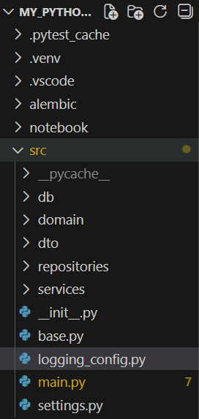
Logging Structure
logging_config.py – sets up our settings for log level and how logs actually print
Default Log Levels in Python logger:
DEBUG – detailed info, only for development
INFO – Confirmations things are working
WARNING – still working as expected, but indication something unexpected happened
ERROR – Due to a more serious issue, the app was not able to perform a function at all
CRITICAL – A serious error that may crash the entire app
Mnemonic: DIWEC
Don’t Ignore Warnings Errors are Critical

Slide 14
logging_config.py
setup_logging() – will only run once at startup
level=logging.INFO – means that only INFO messages and more severe will be captured
C-style string formatting is preferred for logs (lazy formatting performance boost)
%()s <- ‘s’ format as string
There is also d=int, f=float, r=repr(), x=hex
Again, we SHOULD NOT print logs to files. Once our app is hosted, host providers typically read from stdout and stderr.
import logging
def setup_logging():
logging.basicConfig(
level=logging.INFO,
format="%(asctime)s - %(levelname)s - %(name)s - %(message)s",
# filename='app.log'
)

Slide 15

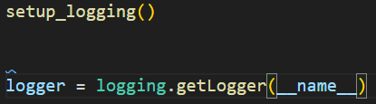

Initializing our setup file (main.py)
setup_logging() is only called once!
But we initiate loggers for each module!
__name__ gets resolved to the module location. Each module gets its own copy (this gives us flexibility later to control what log levels print for each module)
Log automatically shows WHERE it came from!

Slide 16
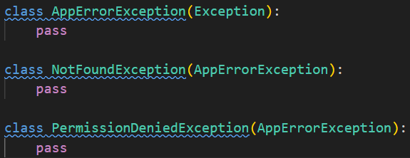
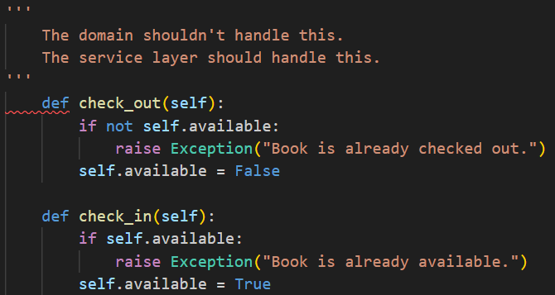
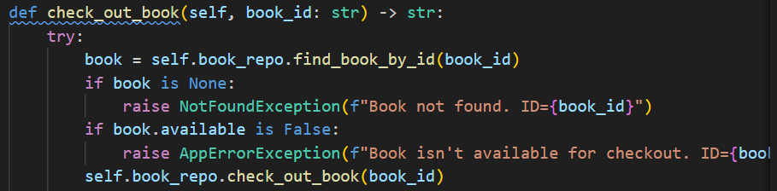
Exceptions
Custom Exceptions in src/domain/exceptions.py:
The service layer is responsible for checking and handling known business exceptions, NOT DOMAIN

Slide 17
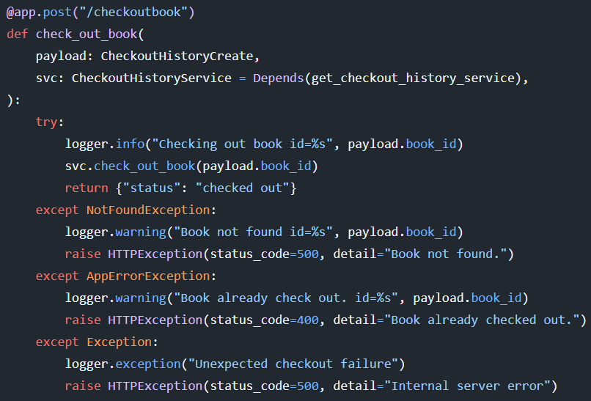
FastAPI HTTPExceptions
The service layer throws exceptions if needed
These are caught here at our endpoint and then:
Logged
HTTPException is raised… but how is it handled? FastAPI Global Exception Handlers!

Slide 18
FastAPI Global Exception Handlers
ORDER MATTERS – HTTPException handler is DECLARED FIRST in main.py. MORE SPECIFIC > MORE GENERAL
This catches all the HTTPExceptions we raise, and handles it:
This catches all UNEXPECTED and UNKNOWN exceptions:
@app.exception_handler(HTTPException)
async def http_exception_handler(request: Request, exc: HTTPException):
logger.exception("HTTP Exception occurred.")
return JSONResponse(
status_code=exc.status_code,
# safe to return detail here - this is intentional
content={"detail": exc.detail},
)
@app.exception_handler(Exception)
async def global_exception_handler(request: Request, exc: Exception):
logger.exception("Unhandled exception")
return JSONResponse(
status_code=500,
# here we give a vague message; we are NOT exposing execution details to the client
content={"detail": "Internal server error"},
)

